Slide 1

Deep Learning Workshop
with
Daniel L. Silver, Ph.D.
Andy McIntyre, Ph.D.
October 22, 2020

Slide 2
Welcome !
Introductions
Instructors: Danny Silver, Andy McIntyre
Admin: Keilani Tupper
Assistant: Siddardha Kaja
Washrooms …. ?? You’re on your own
Session Feedback Forms

Slide 3
Agenda
6:00 - Welcome, Logistics, Overview
6:10 - Review of Colaboratory
6:20 - Basic BP ANNs & Intro to Tensorflow/Keras
7:00 - Building Deep Networks
7:35 - Break
7:50 - Convolution neural networks (CNNs) for classifying images
8:30 - Recurrent neural networks (LSTMs) for learning sequences
9:10 - Summary and Farewell

Slide 4
Deep Learning Overview

Slide 5
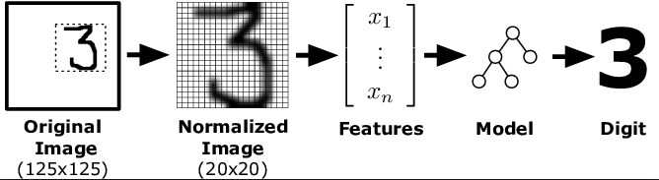
Deep Learning Overview
Traditionally (until 2012), statistical modeling and machine learning used manually created features as inputs
Artificial neural network models were shallow (just a couple of layers)

Slide 6
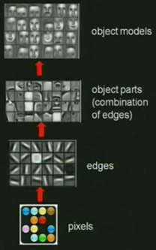
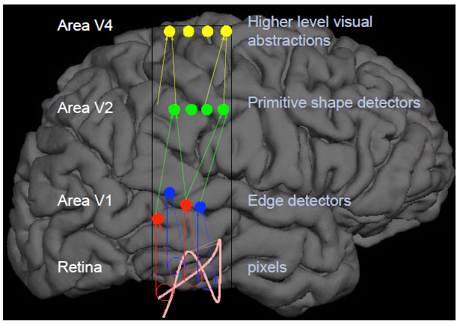
Deep Learning Overview
A deep learning network can learn multiple levels of features from unlabeled data
Simulating human sensory modalities
Unsupervised Feature Learning and Deep Learning – Andrew Ng, Stanford University

Slide 7
Deep Learning Overview
Multiple layers work to build an improved feature space
Lowest hidden layer learns 1st order features (e.g. edges…)
Upper hidden layers learn higher order features (comb. of lower features)
Some models learn hidden node representations in an unsupervised manner and discover general features of the input space (DBN)
Some models learn features in a supervised manner based on architected networks (CNN)
Final layer of transformed features flow into final supervised layer(s) and trained as one large network

Slide 8
Why Deep Learning
Biological Plausibility – e.g. Visual Cortex
Hastad proof - Problems which can be represented with a polynomial number of nodes with k layers, may require an exponential number of nodes with k-1 layers (e.g. parity)
Highly varying functions can be efficiently represented with deep architectures - less weights to update than a less efficient shallow representation
Sub-features created in deep architecture can potentially be shared between multiple tasks – transfer and lifelong machine learning

Slide 9
History of Deep Learning Networks
1980 - Fukushima – Neo-Cognitron
1986 - Rumelhart et al. backpropagation networks
1989 – LeCun - Convolutional Neural Nets for images (but hard to train)
1990s - Interest subsides as other models are introduced – SVMs, Graphical models, etc. – each their turn...
2006 - Deep Belief Networks (Hinton) and Stacked Autoencoders (Bengio) – Unsupervised pre-training followed by supervised learning
2012 - Initial successes with supervised approaches which overcome vanishing gradient and are more general applicable
2014 – Deep CNNs become better than humans for object recog in images
2013 – Schmidhuber - Deep recurrent neural networks (LSTMs, GRUs)

Slide 10
Google’s Colaboratory

Slide 11
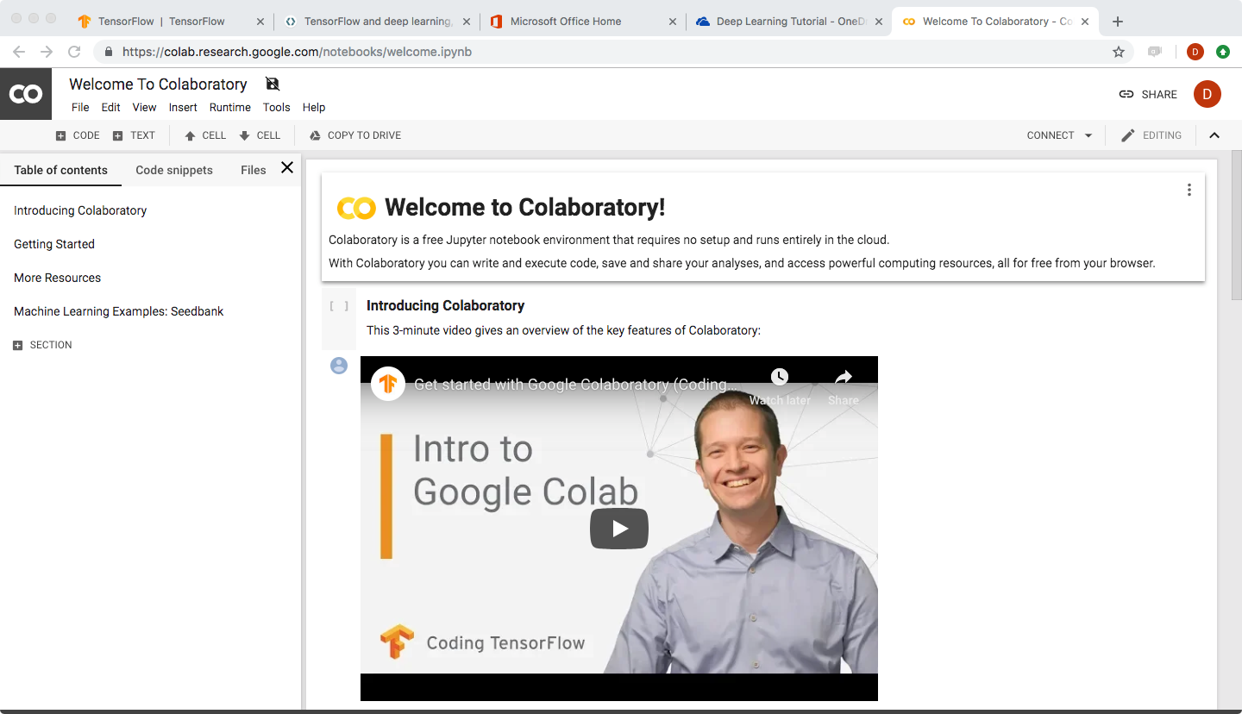
What is Colaboratory?
A free Jupyter notebook environment
Requires no setup and runs entirely in the cloud
You can write and execute code
Save and share your analyses
Access powerful computing resources
All for free from your browser
Overview of Colaboratory

Slide 12
References:
The Major Research Groups (two of which are Canadian):
http://deeplearning.net/
http://www.cs.toronto.edu/~hinton/
http://www.andrewng.org/
http://people.idsia.ch/~juergen/
Other Links:
https://www.coursera.org/courses?languages=en&query=machine+learning+andrew+ng
https://deeplearning4j.org/index.html
http://www.deeplearningbook.org/

